Slide 1
CREDIT EDA CASE STUDY
BY: SREEDEVI GATTU & DISHANT PATEL

Slide 2
DATA OVERVIEW
Two datasets were provided: Application data & Previous Application
These datasets capture various parameters about the clients which would aid the decision to approve or reject the loan application
This data has both categorical & numerical variables
The task demands the analysis of data & draw insights from the data.

Slide 3
PROBLEM STATEMENT
Approval of loan has two basic risks involved (Risk: Loss of business for Bank):
Non approval of loans to a client who could repay the loans
Approval of loans to a client who may become a defaulter
Column ‘TARGET’ defines the status of the client, 1 represents the clients who had paid installments without any difficulties and 0 otherwise
Four major decisions may be taken viz. Approved, Rejected, Cancelled & Unused offer
The main aim of the task is to determine the driving factors which could lead a client to turn into defaulter
On the flip side, bank also needs to determine the key factors which determines that client would repay the loan on time

Slide 4
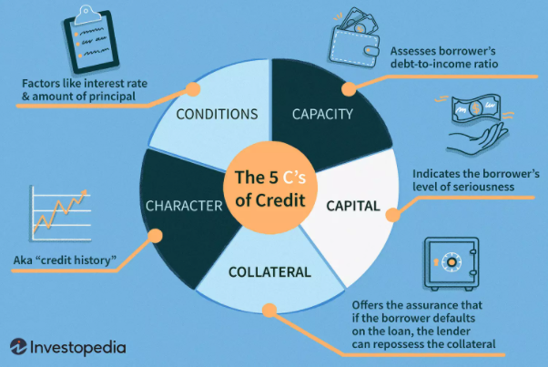
BASIS OF MAKING DECISION – THE 5 C MODEL

Slide 5
RESULT OF APPLICATION STATUS
For making decision on approval of loans, the famous 5C model of Credit was used
The 5 C’s with brief description are as below
CONDITIONS – Factors like interest rate and principal amount
CAPACITY – Debt to income ratio (basically determining capacity of loan repayment)
CHARACTER – Credit History
CAPITAL – Borrower’s level of seriousness
COLLATERAL – In case of default, how lender can monetize collateral

Slide 6
EDA – BASIC STUDY OF DATA AT HAND
First of all importing of all relevant libraries viz. numpy, pandas, seaborn & matplotlib
Reading of data using pd.read_csv function in pandas
Next we need to have a basic overview of the overall data, the shape and size of the application data csv file.
Then we would take a glimpse on all categorical and numerical data
As a basic step we would look into the missing values in the column, depending on the column type, we need to analyze the reason of missing data and either delete or put the missing values.
We start with Application Data set

Slide 7
DIVISION OF COLUMNS INTO LOGICAL GROUPS
Demographic_Personal Columns – Gender, Age, Children Count, Family member count, Family status, Housing type, Relative Population, Region rating of client
Demographic_Professional – Education, Income, Occupation, Organization
Character Columns – Columns which descript calls made to credit bureau
Social_Circle Columns – Observation of clients post 30 or 60 days past due date
Documents Columns – All columns which shows flag of Documents
Building Columns – All columns which descript address of client
Ext Source columns – Ext 1,2 & 3 columns

Slide 8
DIVISION OF COLUMNS AS PER 5 C MODEL
Demographic_Personal Columns – Gender, Age, Children Count, Family member count, Family status, Housing type, Relative Population, Region rating of client
Character – Credit Worthiness, Calls to Credit Bureau, Credit History, Social Circle
Capacity – Debt to Income ratio, Income, Credit, Goods
Capital – Down payment size, Owing Car/ Relaity
Condition-
Collateral-

Slide 9
DATA IMBALANCE
 | TARGET | Count | %
0 | 0 | 282686 | 91.93
1 | 1 | 24825 | 8.07
This suggests that the clients with payment difficulties are much less as compared to the clients without payment difficulties.
To avoid the same, analysis needs to be done as percentages

Slide 10
HANDLING OF MISSING DATA
All columns related to building data is has 50% or more data missing. In some cases it is close to 50, viz. 48 or 49.
In this case these particular columns are removed from the dataframe and no further analysis is done on such data
Also columns EXT Source 1,2 & 3 have been removed as EXT source 1 has more than 50% data is missing
After removal of these columns we are left with 70 columns
No duplicate rows were found in the dataset

Slide 11
STRATEGY FOR DATA ANALYSIS
The variables/columns are categorised into following categories. Further analysis will be done for each category
Demographic - PERSONAL: 9 cols
Demographic - PROFESSIONAL:
Character - Credit Worthiness:
Capacity
Capital
Id, Target - 2
For each category, following analysis is to be done:
Inspection of dataset
Inspect for missing values and handle
Find correlation
Univariate analysis
Bivariate analysis
Observations/Insights

Slide 12
DEMOGRAPHIC - PERSONAL
Both REGION_RATING_CLIENT and REGION_RATING_CLIENT_W_CITY indicate a similar trait. So only one can be considered. REGION_RATING_CLIENT_W_CITY ratings >= REGION_RATING_CLIENT. So let's drop REGION_RATING_CLIENT and go only with REGION_RATING_CLIENT_W_CITY
REGION_RATING_CLIENT, REGION_RATING_CLIENT_W_CITY are numerical discrete type. But these should be categorical.

Slide 13
HANDLING MISSING DATA – DEMOGRAPHIC PERSONAL
COLUMN(S) | Data type | Missing & Invalid value Strategy
CODE_GENDER | Categorical Unordered | 4 rows with XNA. Remove these rows
DAYS_BIRTH | Numerical continuous | DAYS_BIRTH is a relative (-ve) value (in days) to the application. Convert it to AGE adn then bin the values.
CNT_CHILDREN | Numerical discrete | No missing/invalid values
CNT_FAM_MEMBERS | Numerical discrete | 2 items are missing. Impute this with the median value (typical value)
NAME_FAMILY_STATUS | Categorical Unordered | 2 rows have 'Unknown'. Remove these rows
HOUSING_TYPE | Categorical Unordered | No missing/invalid values
REGION_POPULATION_RELATIVE | Numerical continuous | No missing/invalid values
REGION_RATING_CLIENT | Numerical continuous --> Categorical Ordered | As REGION_RATING_CLIENT & REGION_RATING_CLIENT_W_CITY have similar data, drop the column REGION_RATING_CLIENT
REGION_RATING_CLIENT_W_CITY | Numerical continuous --> Categorical Ordered | No missing/invalid values

Slide 14
HANDLING OUTLIERS– DEMOGRAPHIC PERSONAL
Outliers (beyond the lower and upper fences) exist for
CNT_CHIDLREN : > 2.5 till 19
CNT_FAM_MEMBERS : > 5 till 20
REGION_POPULATION_RELATIVE : 1 area is heavily populated compared to the rest
Action on Outliers
The values are genuine values and no action is taken as of now

Slide 15
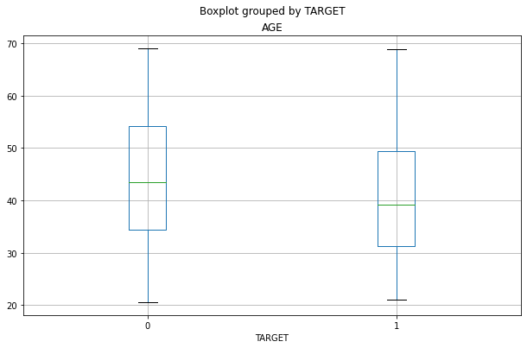
PLOT – AGE- DEMOGRAPHIC PERSONAL
No outliers for Age

Slide 16
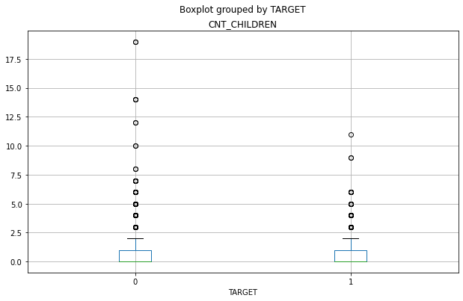
PLOT – CHILDREN CNT- DEMOGRAPHIC PERSONAL
Outliers on the upper side of the plot

Slide 17
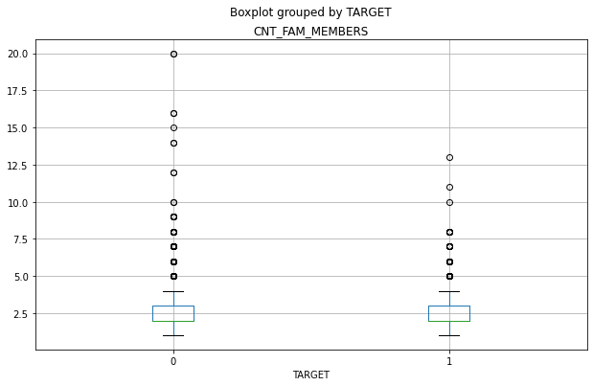
PLOT – FAMILY MEMBER CNT– DEMOGRAPHIC PERSONAL
Outliers on the upper side of the plot

Slide 18
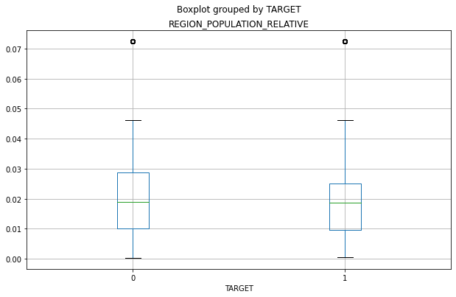
PLOT – RELATIVE POPULATION - DEMOGRAPHIC PERSONAL
One region is having very high population w.r.t. others

Slide 19
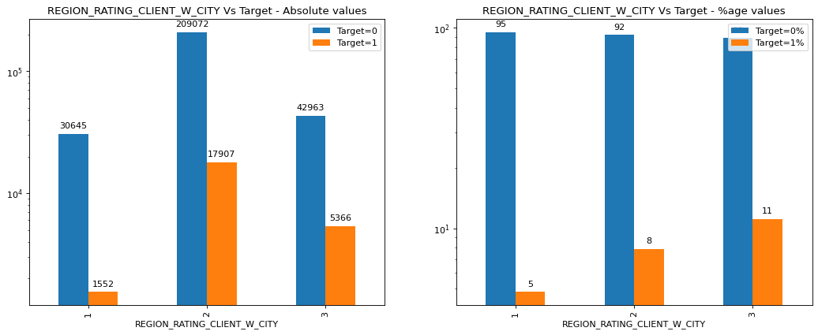
UNIVARIATE ANALYSIS - REGION RATING
Region Rating – Problems with client increases in Region 3

Slide 20
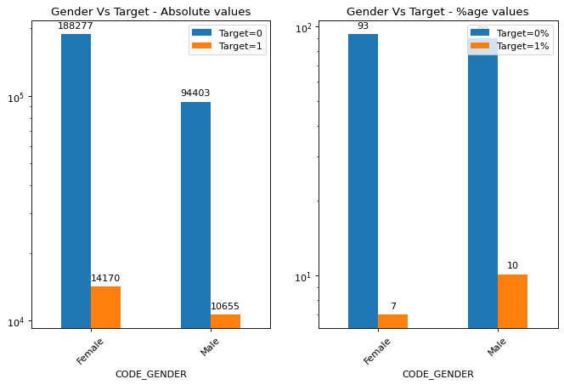
UNIVARIATE ANALYSIS - GENDER
Males tend to have more problems as compared to females

Slide 21
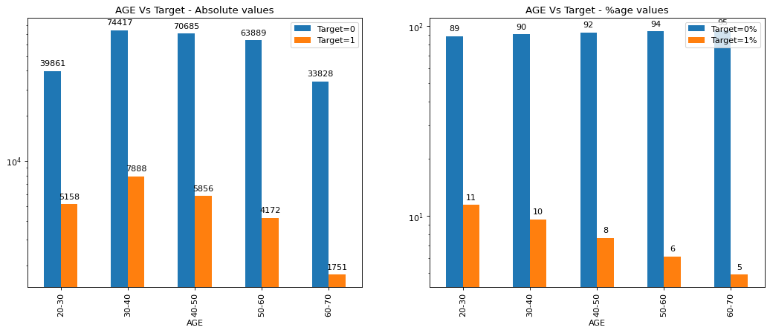
UNIVARIATE ANALYSIS- AGE
Younger people have more difficulties in payment

Slide 22
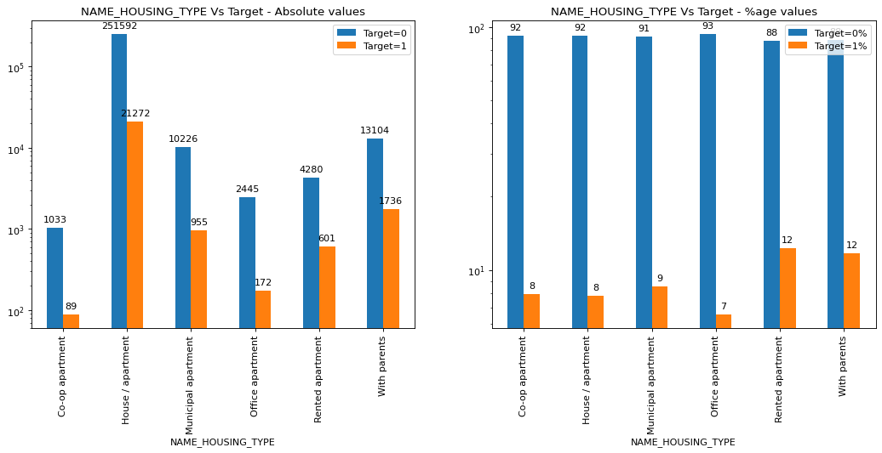
UNIVARIATE ANALYSIS- HOUSING TYPE
People living in rented apartments & living with parents face issues

Slide 23
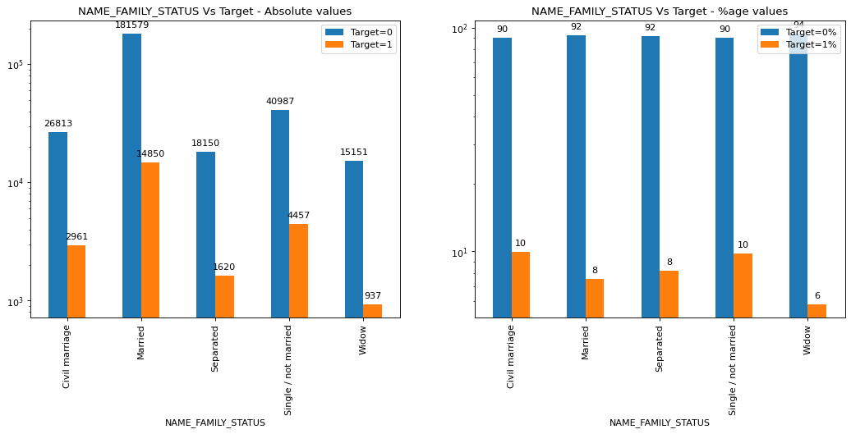
UNIVARIATE ANALYSIS- FAMILY STATUS
Single/ Civil married people have difficulties – but not such sharp difference

Slide 24
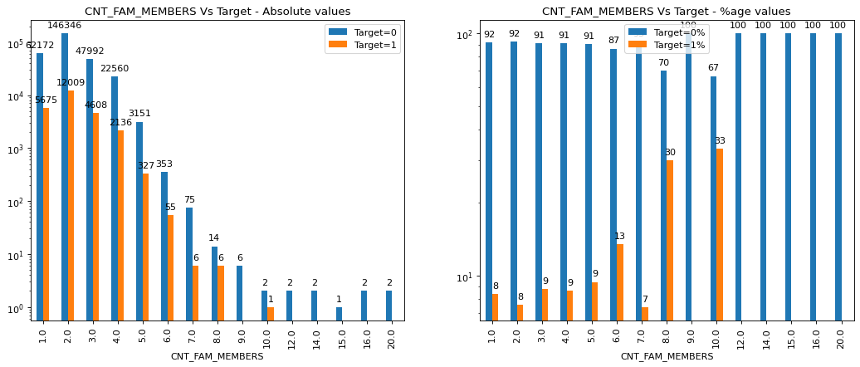
UNIVARIATE ANALYSIS- CHILDREN COUNT
If Children count increases beyond 6, then client has repayment issues

Slide 25
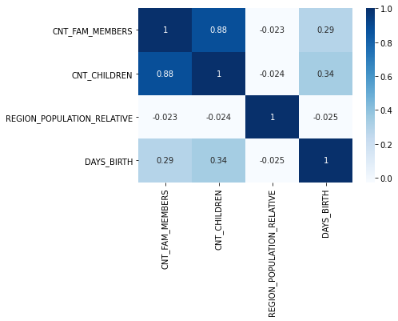
CORELATION –HEAT MAP
CNT_CHILDREN & CNT_FAM_MEMBERS have strong +ve correlation

Slide 26
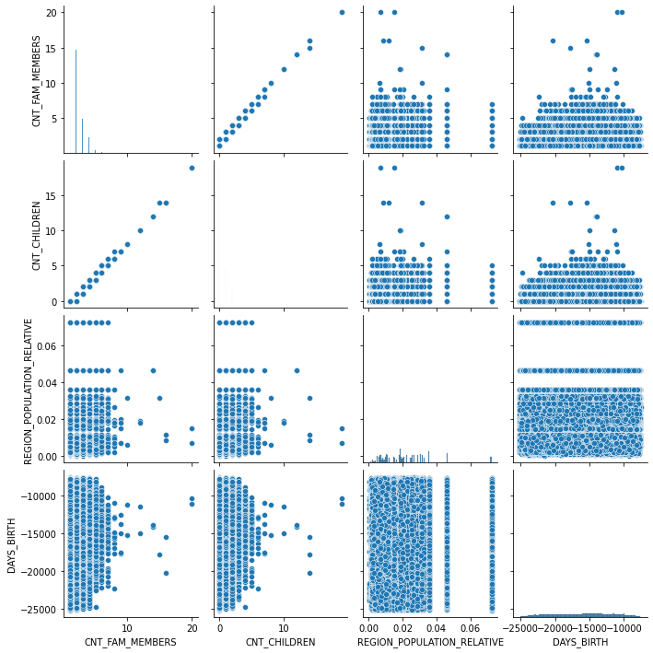
CORELATION – PAIR PLOT

Slide 27
OVERALL OBSERVATIONS
COLUMN(S) | Invalid values/Outliers? | Observation | Difficulties in paying | No difficulties in paying
CODE_GENDER | None | More percentage of male clients have difficulties in paying | Male Clients | Female clients
DAYS_BIRTH --> AGE | None | Lesser age, more difficulty in paying | Younger Clients | Older clients
CNT_CHILDREN | > 2.5 till 19 | With increase in number of kids, the ability to pay decreases. | More children | Less children
CNT_FAM_MEMBERS | > 5 till 20 | With increase in number of family members, the ability to pay decreases | Larger family size | Smaller family size
NAME_FAMILY_STATUS | None | No clear observation | Civil Married Single/Not Married | Widow
HOUSING_TYPE | None | Clients in Rented apartment or staying at parents house have difficulties in paying off
REGION_POPULATION_RELATIVE | One value is highly populated
REGION_RATING_CLIENT, REGION_RATING_CLIENT_W_CITY | None | Higher the region, the clients find it more difficult to pay. Clients from regions 3 have difficulty in paying off | Higher Region category | Lower Region category

Slide 28
DEMOGRAPHIC - PROFESSIONAL
Target Columns – Education/ Income/Organization Type

Slide 29
DEMOGRAPHIC – MISSING VALUES
COLUMN(S) | Data type | Missing & Invalid value Strategy
NAME_EDUCATION_TYPE | Categorical Ordered | No missing/invalid values
NAME_INCOME_TYPE | Categorical Unordered | No missing/invalid values
ORGANIZATION_TYPE | Categorical Unordered | No missing/invalid values

Slide 30
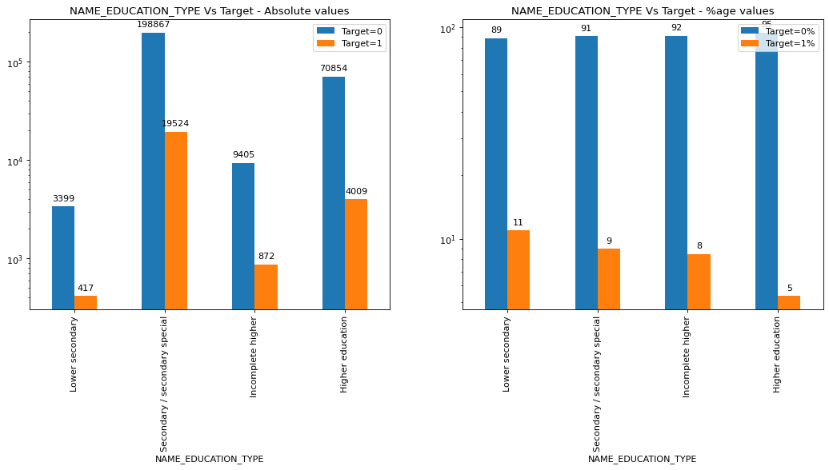
UNIVARIATE ANALYSIS-EDUCATION TYPE
Lower educated people have difficulties in Loan repayment

Slide 31
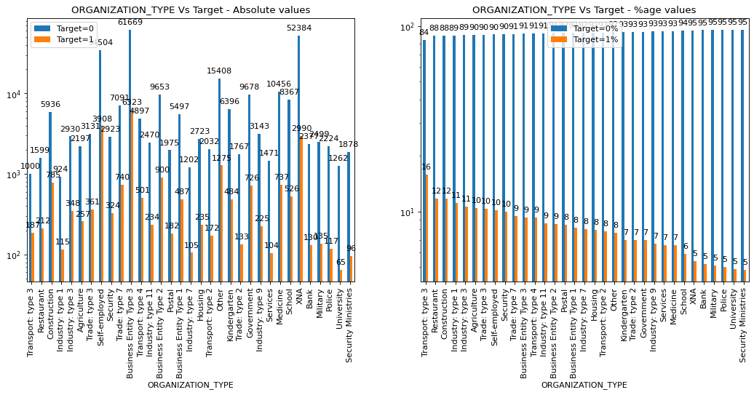
UNIVARIATE ANALYSIS-ORGANIZATION TYPE
Transport/ Restaurant/ Construction have payment issues

Slide 32
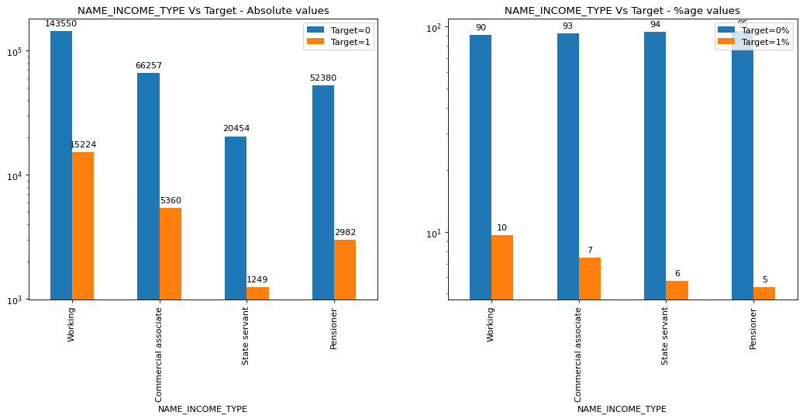
UNIVARIATE ANALYSIS-INCOME TYPE
Working Class face issues as compared to other classes

Slide 33
OVERALL OBSERVATIONS
COLUMN(S) | Outliers? | Observation | Difficulties in paying | No difficulties in paying
NAME_EDUCATION_TYPE | None | With increase in education, the ability to pay increases. | Clients with lesser education | Clients with higher education
NAME_INCOME_TYPE | None | None | Working | Pensioner, State Servant
ORGANIZATION_TYPE | None | None | Transport Type 3 | Bank

Slide 34
CHARACTER- CREDIT WORTHINESS
Calls to Credit Bureau
Credit history - How many previous applications were rejected?
Rejected loan application
Defaulted on several debt payments
Difficulty getting a job
Difficulty getting an apartment to rent
Social Circle
This data is present in the Previous data application dataset

Slide 35
Credit history: a borrower's reputation or track record for repaying debts
HANDLING MISSING DATA
AMT_DOWN_PAYMENT, RATE_DOWN_PAYMENT, RATE_INTEREST_PRIMARY, RATE_INTEREST_PRIVILEDGED, DAYS_FIRST_DRAWING, DAYS_FIRST_DUE, DAYS_LAST_DUE
DAYS_TERMINATION, NFLAG_INSURED_ON_APPROVAL, NAME_TYPE_SUITE, NAME_CASH_LOAN,
NAME_PRODUCT_TYPE, NAME_SELLER_INDUSTRY,NAME_GOODS_CATEGORY
All the above mentioned rows have about 40% data missing, thus the above mentioned columns are dropped from the dataframe
AMT_ANNUITY, AMT_GOODS_PRICE,CNT_PAYMENT has about 23% data missing

Slide 36
ANALYSIS OF APPLICATIONS
Group by is done on the basis of SK_ID_CURR, this step would show how many previous applications were there and what were it’s status (viz. Approved, rejected etc.)
Summary of Previous applications:
Other than Previous, Approved and rejected other types of applications are clubbed as OTHERS as their quantity is less
 | Total Prev Apps | Approved | Canceled | Refused | Unused offer
TARGET
0 | 91.35 | 92.41 | 90.82 | 88.0 | 91.77
1 | 8.65 | 7.59 | 9.18 | 12.0 | 8.23

Slide 37
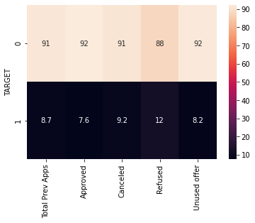
ANALYSIS OF APPLICATIONS

Slide 38
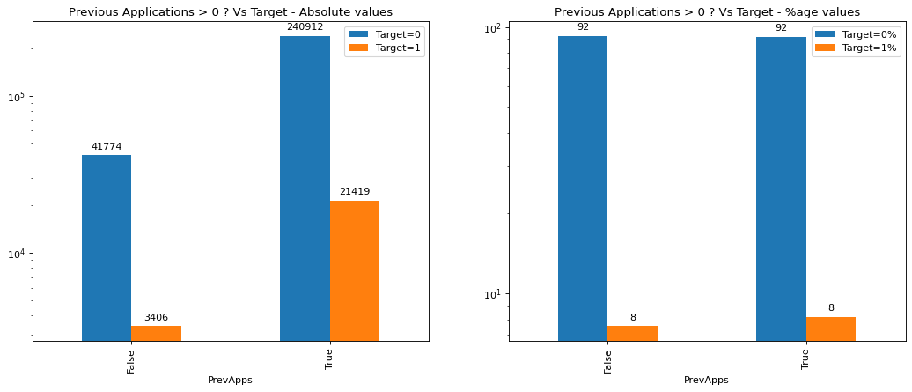
UNIVARIATE ANALYSIS – PREVIOUS APPLICATIONS
Not much difference

Slide 39
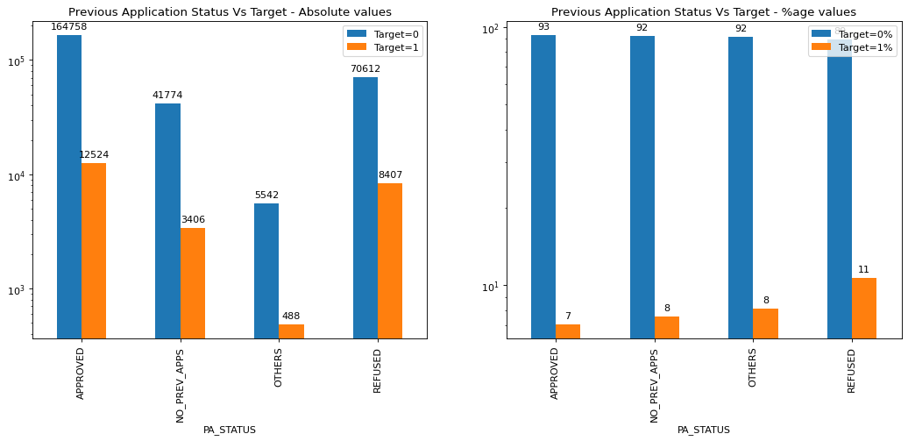
UNIVARIATE ANALYSIS – PREVIOUS APPLICATIONS
This shows that if previous loans were refused, clients face difficulty in payment

Slide 40
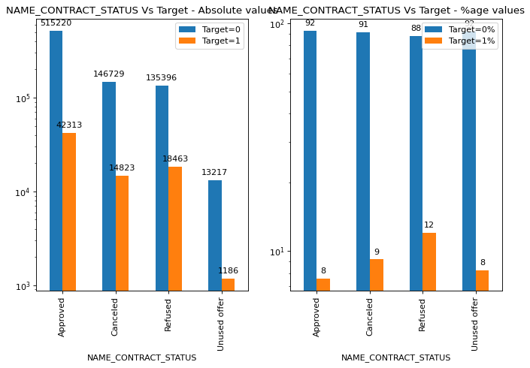
UNIVARIATE ANALYSIS – NAME CONTRACT STATUS
This shows that if previous loans were refused, clients face difficulty in payment

Slide 41
CALLS TO CREDIT BUREAU
HANDLING MISSING DATA
13.5 % data is missing in columns Amount Req Bureau Hour/ Day/ Week/Month/Qrt & year
This can be classified as Missing Not at Random (MNAR). This may be because this data was not captured or was not available while preparing the data.
COLUMN(S) | Data type | Missing & Invalid value Strategy
AMT_REQ_CREDITBUREAU* | Numerical discrete | 13.5% missing values - Add values from all the columns into a single column "ENQUIRIES_CREDIT_BUREAU" which will give the total number of calls in one year before application. - Either all the columns are filled or non of them are filled (NaN). So we can safely add the values of all the columns

Slide 42
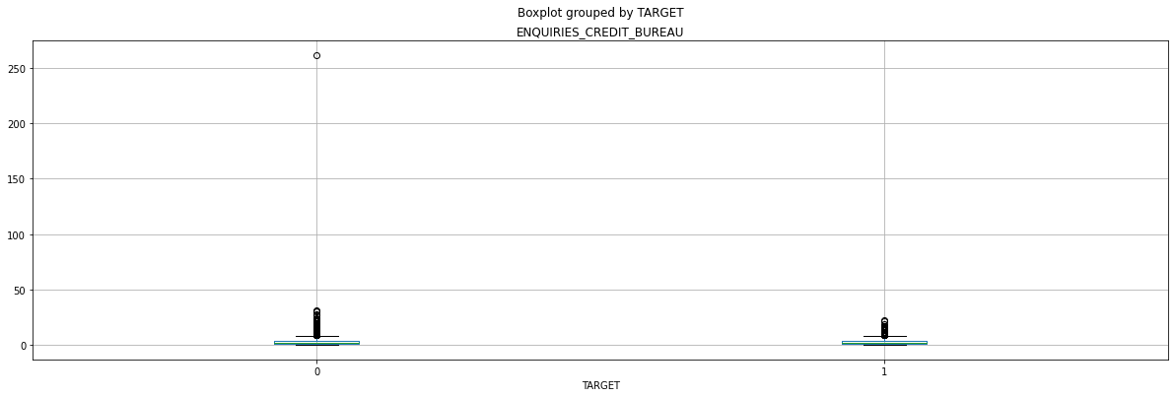
BOX PLOT – GROUPED BY TARGET
Presence of Outliers

Slide 43
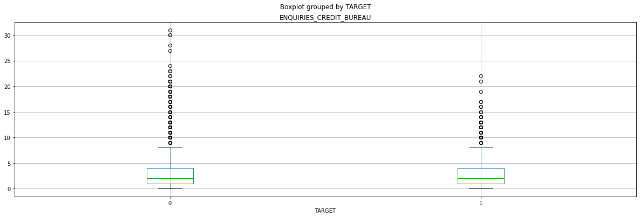
BOX PLOT – GROUPED BY TARGET
BOX PLOT – AFTER REMOVAL OF OUTLIER (no. of calls: 262)

Slide 44
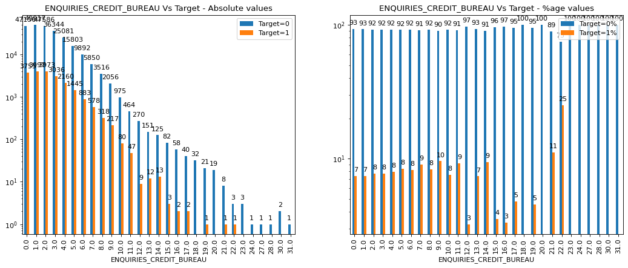
BARPLOT – ENQUIRIES_CREDIT_BUREAU
Calls greater than 20 can show client with issues

Slide 45
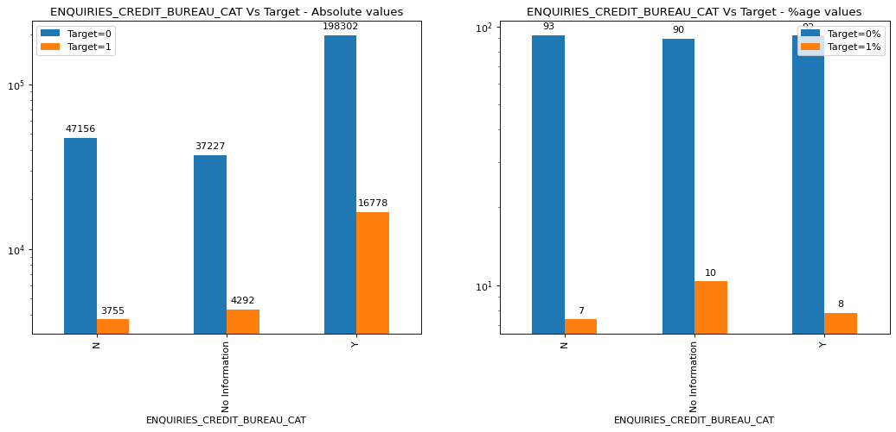
BARPLOT – ENQUIRIES_CREDIT_BUREAU

Slide 46
SOCIAL CIRCLE
For doing this study we need to calculate a variable (PC_SOCIAL_CIRCLE)
We take a sum of observable 30 & 60 DPD and defaulted 30 & 60 DPD and assign new columns to this data
DEF_PC_SOCIAL_CIRCLE is defined as percentage of sum of observable 30 & 60 DPD to defaulted 30 & 60 DPD
We would know about the relative strength of defaulters in client’s vicinity/ social circle
The study would show if the presence of these defaulters in client’s social surrounding affects the client’s tendency to repay the loan

Slide 47
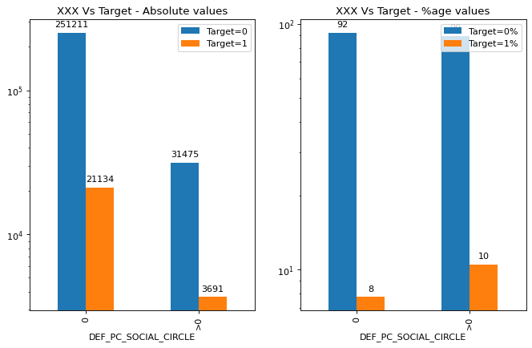
BARPLOT – SOCIAL CIRCLE
Clients who have greater defaulters in social circle may also default

Slide 48
OVERALL OBSERVATIONS - SOCIAL CIRCLE
COLUMN(S) | Missing Values? | Outliers? | Observation | Difficulties in paying | No difficulties in paying
ENQUIRIES_CREDIT_BUREAU | 13.5% Create a new category "Unknown" | Yes. 262. Can be removed. | Whether there were calls to Credit Bureau or not does not seem to indicate clients capability to pay loans | NA | NA
PREV_APPS | None | None | Having Prev Apps does not indicate any difficulty or otherwise | With PrevApps refused | Accountants
SOCIAL_CIRCLEDEFAULT% | None | None | Clients with defaulters in social circle | Clients with higher percentage of defaulters in social circle | Clients with lesser %age of defaulters in social circle

Slide 49
CAPACITY
Borrower's ability to repay the loan
Debt-to-income (DTI) ratio = total monthly debt/gross monthly income
DTI < 35% is safe
Length of time an applicant is employed at their current job
Borrower's ability to repay the loan
Current debt
Income
Length of time employed at current job
AMT_INCOME_TOTAL - numerical, continuous, float
FLAG_OWN_REALTY == 'Y' does not mean the client is staying there.
NAME_HOUSING_TYPE indicates the type of housing where the client is staying. Not what he/she owns.

Slide 50
CAPACITY
COLUMN(S) | Data Type | Missing & Strategy
AMT_INCOME_TOTAL | Numerical continuous | None
AMT_GOODS_PRICE | Numerical continuous | 112 % of the goods price
AMT_CREDIT | Numerical continuous | None
AMT_ANNUITY | Numerical continuous | 5% of the Credit amount

Slide 51
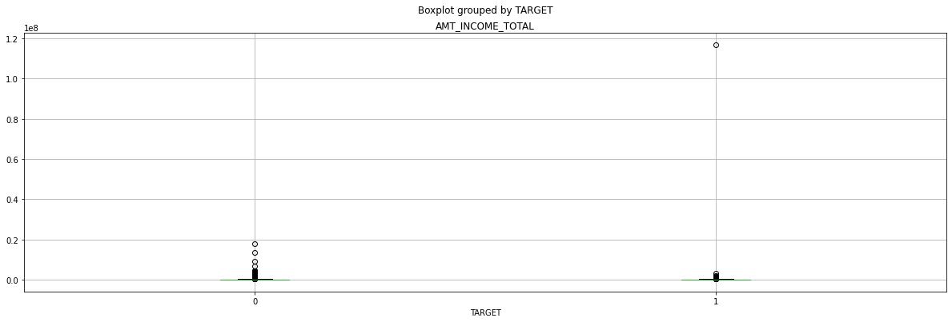
BOX PLOT - AMOUNT INCOME
Presence of outlier

Slide 52
BOX PLOT - AMOUNT INCOME
Presence of outliers
Income is generally rangebound with few exceptions
Binnnig the income into groups would provide some insights

Slide 53
AMOUNT INCOME - BINNING
The income is binned into 4 quantiles (0,0.25,0.5.0.75,1)
INCOME_GROUP | Total | Target=1 | Target=0 | Target=1% | Target=0%
Q1 | 100576 | 8442 | 92134 | 8.39 | 91.61
Q2 | 53182 | 4537 | 48645 | 8.53 | 91.47
Q3 | 82213 | 6902 | 75311 | 8.40 | 91.60
Q4 | 71538 | 4943 | 66595 | 6.91 | 93.09

Slide 54
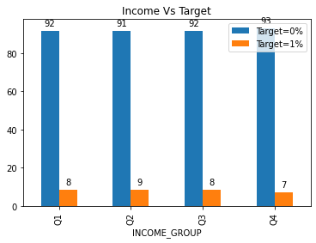
BOX PLOT - AMOUNT INCOME
No significant difference

Slide 55
AMOUNT INCOME – BINNING INTO INCOME GROUPS
The income is binned into 5 categories, <50k, <1L, <10L,<50L & >50L
INCOME_GROUP | Total | Target=1 | Target=0 | Target=1% | Target=0%
<50K | 4517 | 343 | 4174 | 7.59 | 92.41
<1L | 59181 | 4882 | 54299 | 8.25 | 91.75
<10L | 243563 | 19587 | 223976 | 8.04 | 91.96
<50L | 245 | 12 | 233 | 4.90 | 95.10
>50L | 5 | 1 | 4 | 20.00 | 80.00

Slide 56
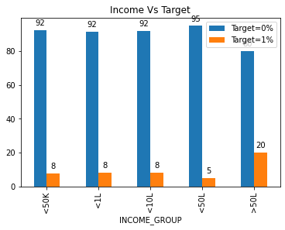
BOX PLOT – INCOME GROUPS
Higher Income ranges face difficulty in payment, which is contradictory of common convention

Slide 57
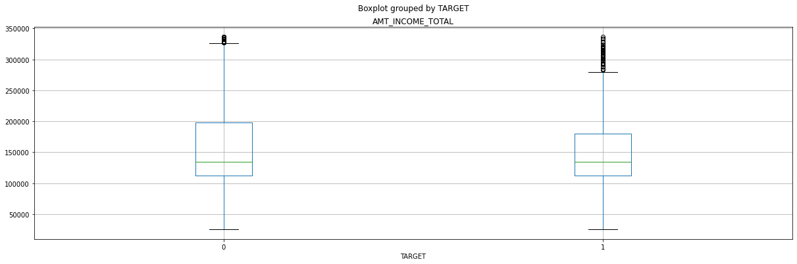
BOX PLOT – AFTER REMOVAL OF OUTLIERS IN INCOME

Slide 58
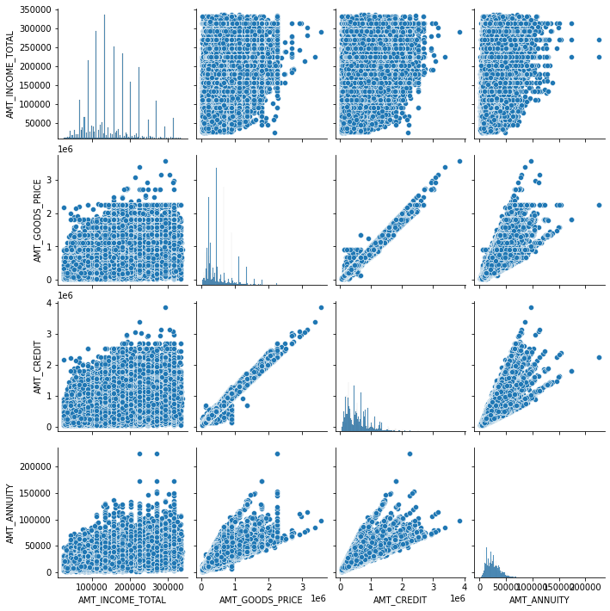
CORRELATION – INCOME/GOODS/CREDIT/ANNUITY

Slide 59
CORRELATION – OBSERVATIONS
AMT_CREDIT, AMT_GOODS_PRICE - Strong +ve
AMT_ANNITY & AMT_CREDIT, AMT_GOODS_PRICE - Strong +ve
AMT_INCOME_TOTAL & AMT_GOODS_PRICE & AMT_CREDIT

Slide 60
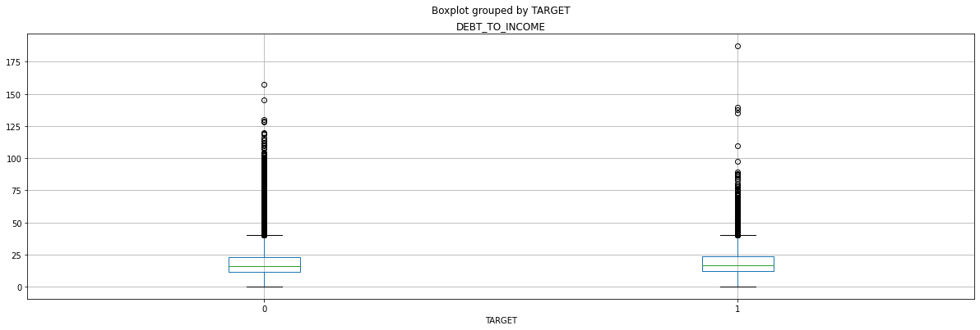
DEBT TO INCOME
As per the definition Debt to income ratio of Annuity Amount to Income
Outliers present in the data

Slide 61
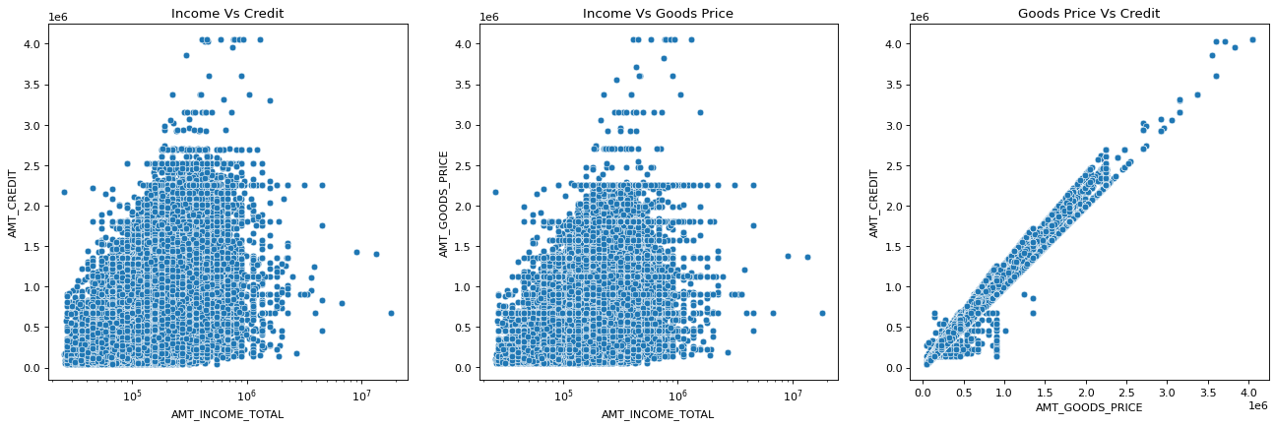
PLOT – Income vs Credit/Goods Price Goods price vs Credit
Positive Correlation between Goods Price and Credit

Slide 62
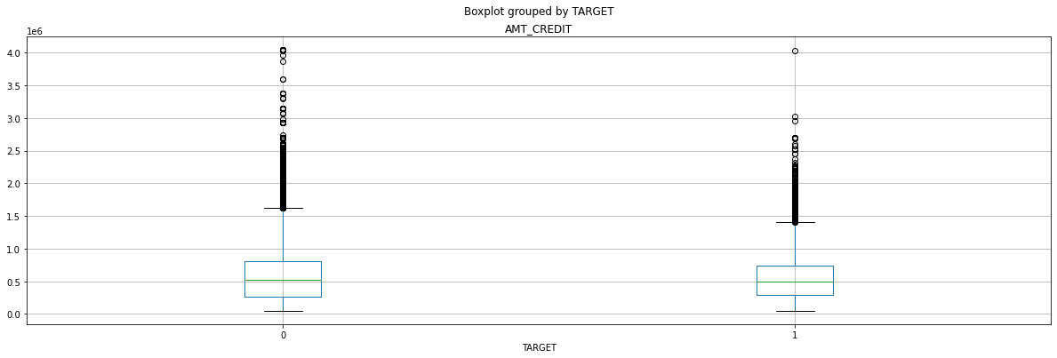
BOXPLOT – AMOUNT CREDIT
Similar behaviour for target 0 or 1

Slide 63
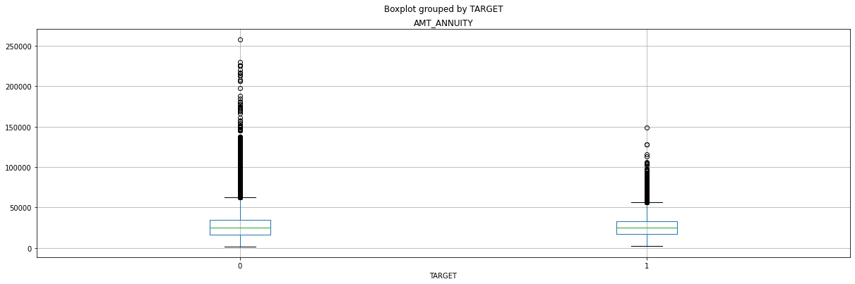
BOXPLOT – AMOUNT ANNUITY
Similar behaviour for target 0 or 1

Slide 64
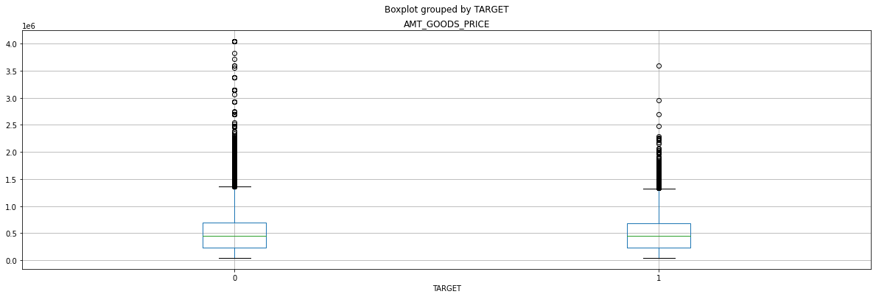
BOXPLOT – GOODS PRICE
Similar behaviour for target 0 or 1

Slide 65
OVERALL OBSERVATIONS – DEBT TO INCOME
COLUMN(S) | Missing Values | Outliers | Observation | Difficulties in paying | No difficulties in paying
DEBT-TO-INCOME
'AMT_CREDIT', 'AMT_ANNUITY', 'AMT_GOODS_PRICE' | None | NA | Independently these does not affect the client's ability to pay
INCOME | None | 11 cr | None | >50L | None

Slide 66
CAPITAL
Down payment indicates borrower's level of seriousness
Down payment size
Overall wealth that borrower possess - Car, Realty
Realty & Car

Slide 67
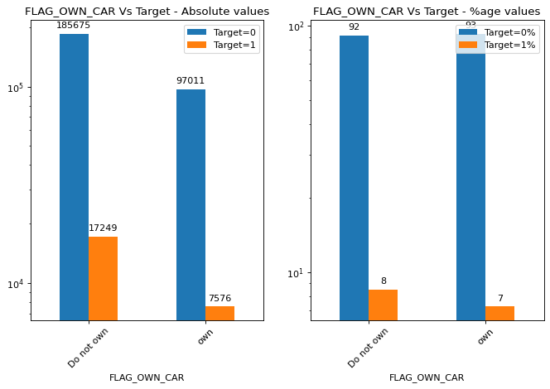
PLOT – OWN CAR
No observable difference

Slide 68
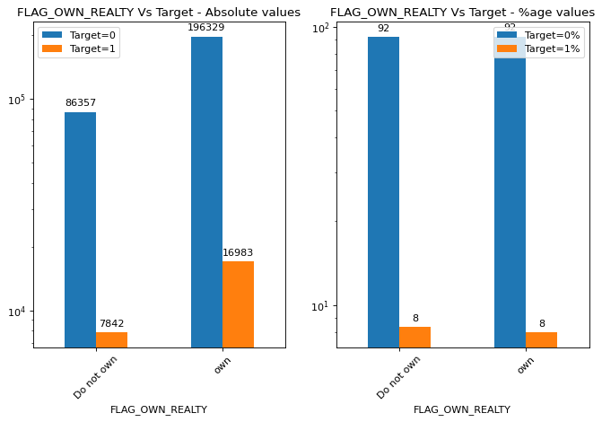
PLOT – OWN REALITY
No observable difference

Slide 69
APPLICATION
This category contains variables related to application
Who accompanied the applicant
Details provided - phone, email, address
Documents submitted
Day & time of the application
Flag Document Section

Slide 70
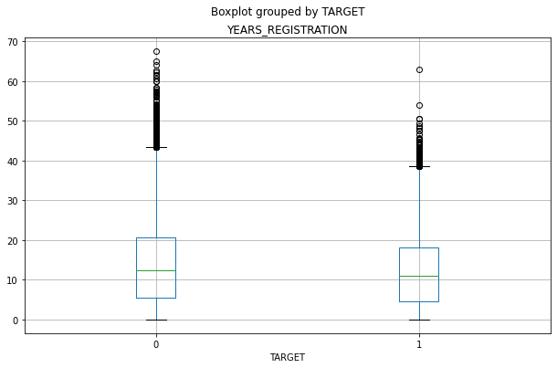
BOX PLOT – GROUPED BY TARGET - YEARS REGISTRATION
Not much difference

Slide 71
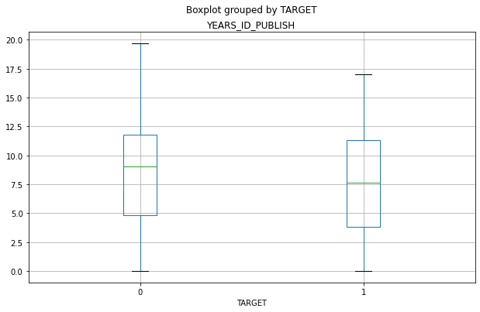
BOX PLOT – GROUPED BY TARGET - YEARS ID PUBLISH
Not much difference

Slide 72
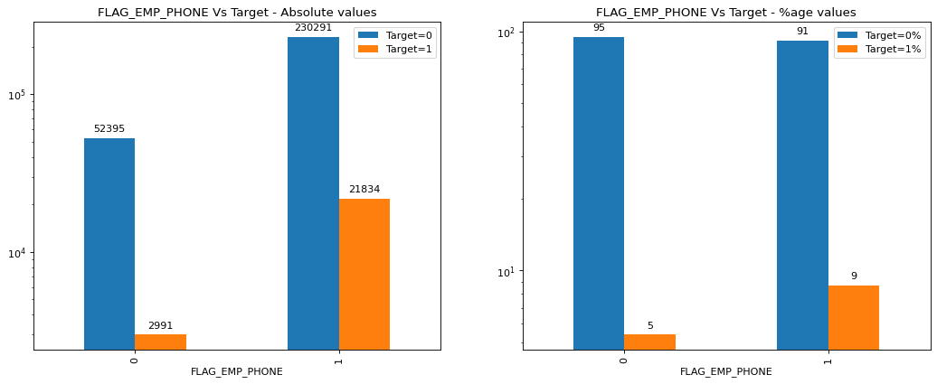
PLOT – HOME PHONE DETAILS
Client who provided Work phone had difficulties

Slide 73
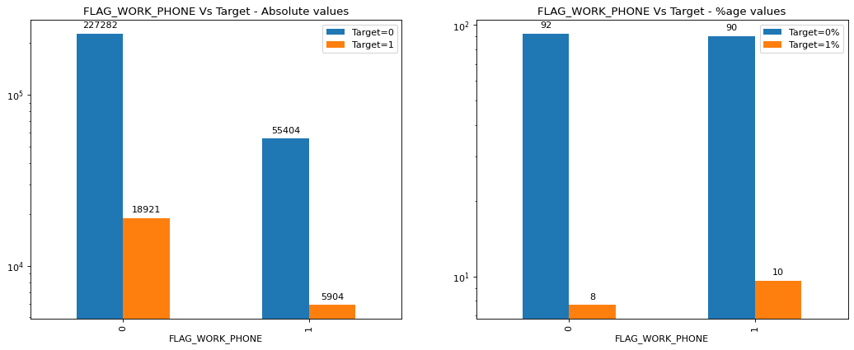
PLOT – WORK PHONE DETAILS
Not much difference

Slide 74
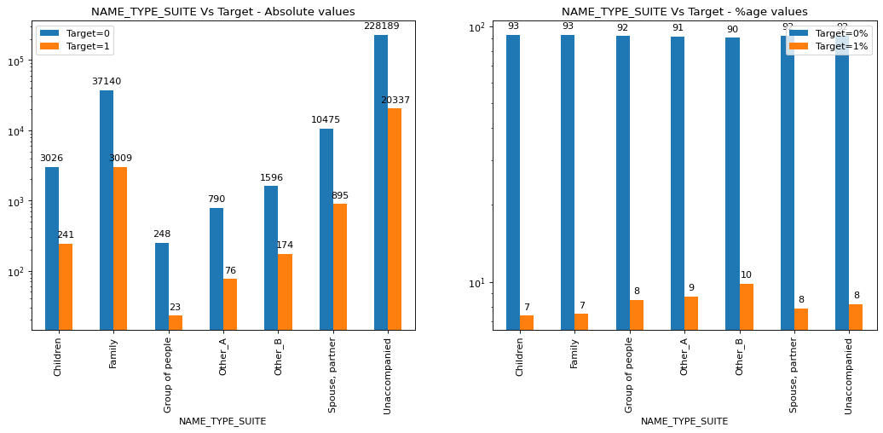
PLOT – NAME SUITE TYPE
Not much difference

Slide 75
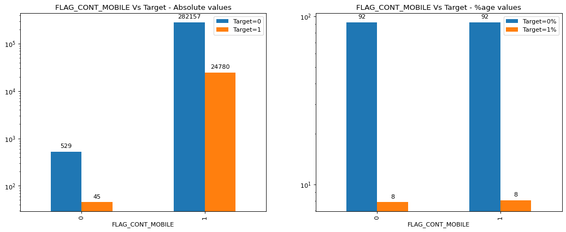
PLOT – MOBILE REACHABILITY
Not much difference

Slide 76
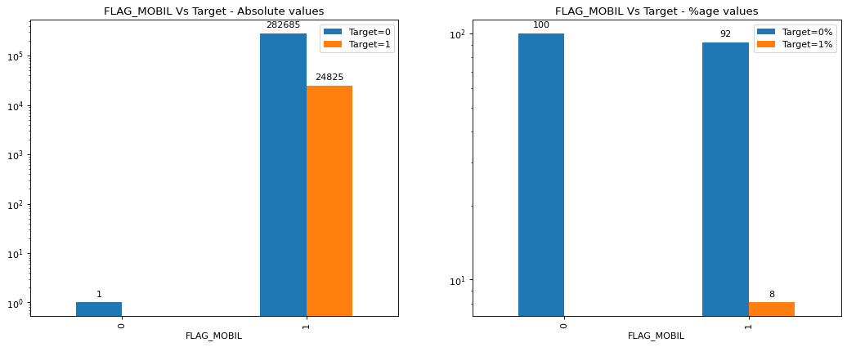
PLOT – DID CLIENT PROVIDE MOBILE NUMBER
Data inconclusive

Slide 77
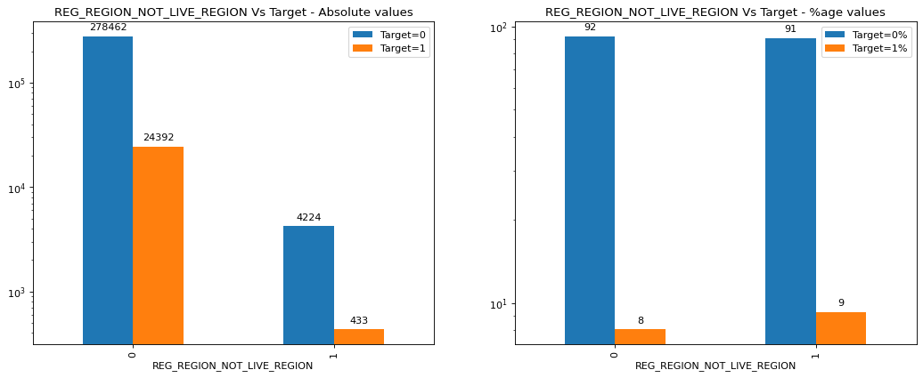
PLOT – IF PERMANENT ADDRESS DOES NOT MATCH WORK ADDRESS
Not much difference

Slide 78
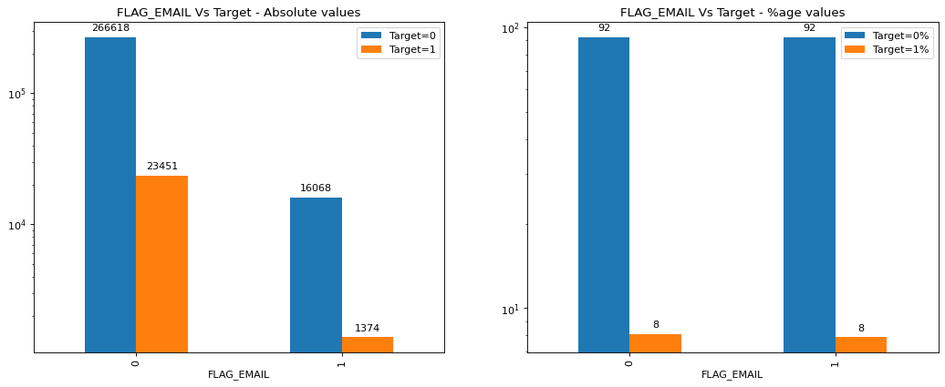
PLOT – DID CLIENT PROVIDE EMAIL ADDRESS
Not much difference

Slide 79
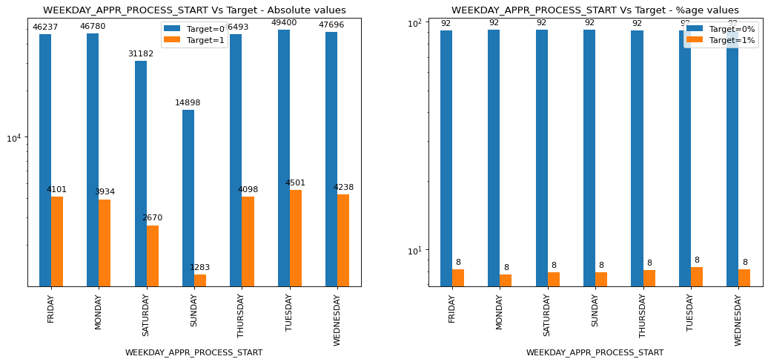
PLOT – WEEKDAY ON WHICH APPLICATION STARTED
Not much difference

Slide 80
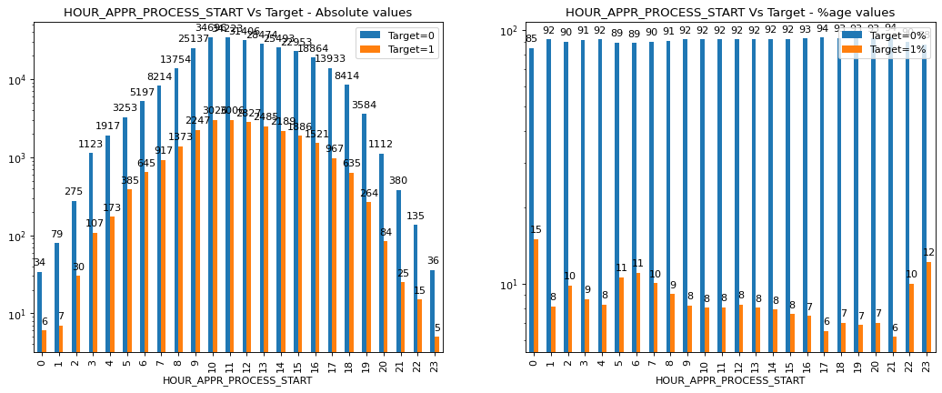
PLOT – WHICH HOUR APPLICATION STARTED
APPLICATION IN NIGHT HOURS 23 to 01 faces issues

Slide 81
PLOT – IF PERMANENT ADDRESS DOES NOT MATCH LIVING ADDRESS
Not much difference

Slide 82
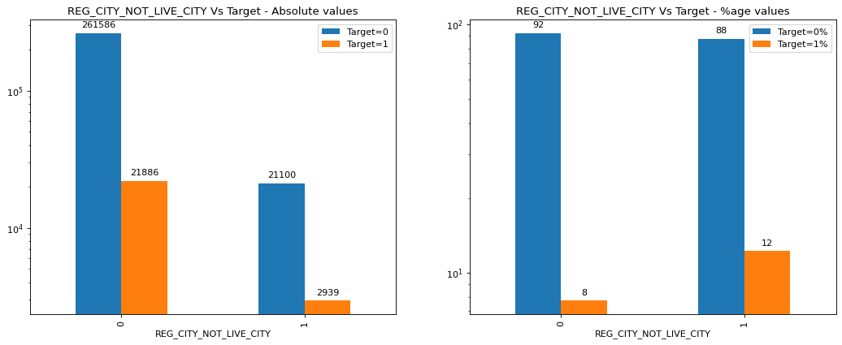
PLOT – IF PERMANENT ADDRESS DOES NOT CONTACT ADDRESS
Non matching addresses have issues

Slide 83
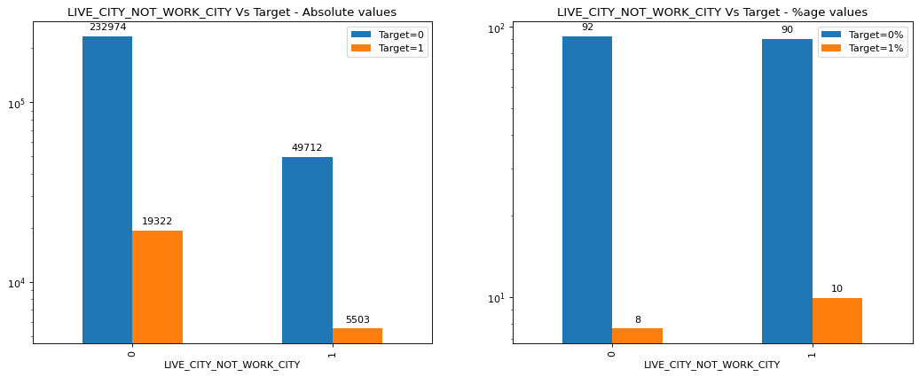
PLOT – IF CONTACT ADDRESS DOES NOT MATCH WORK ADDRESS
Not much difference

Slide 84

PLOT – IF PERMANENT ADDRESS DOES NOT WORK ADDRESS
Not much difference

Slide 85

PLOT – IF PERMANENT ADDRESS DOES NOT WORK ADDRESS
Not much difference

Slide 86

PLOT – IF CONTACT ADDRESS DOES NOT MATCH WORK ADDRESS
Not much difference

Slide 87

CORELATIONS – ALL NUMERICAL

Slide 88

PAIR PLOT – ALL NUMERICAL

Slide 89
TOP 10 CORELATIONS
TOP 10 CORRELATIONS for TARGET=1
AMT_CREDIT & AMT_GOODS_PRICE (0.98)
CNT_CHILDREN & CNT_FAM_MEMBERS (0.89)
AMT_CREDIT & AMT_ANNUITY (0.75)
AMT_GOODS_PRICE & AMT_ANNUITY (0.75)
Prev Apps.NAME_CONTRACT_STATUS=Refused & Tota Prev Apps (0.74)
Prev Apps.NAME_CONTRACT_STATUS=Approved & Tota Prev Apps (0.71)
Prev Apps.NAME_CONTRACT_STATUS=Canceled & Tota Prev Apps (0.67)
ENQUIRES_CREDIT_BUREAU & Tota Prev Apps (0.51)
DEBT-TO-INCOME & AMT_ANNUITY (0.49)
Prev Apps.NAME_CONTRACT_STATUS=Canceled & ENQUIRES_CREDIT_BUREAU (0.47)

Slide 90
CLIENT DETAILS
Majority of the clients are in
HOUSING_TYPE- House/Apartment
NAME_FAMILY_STATUS - Married
CNT_FAM_MEMBERS = 2
CNT_CHILDREN = 0
Age: 30-40
Female
REGION_RATING_CLIENT = 2
Who apply around midnight.

Slide 91
FINAL RECOMMENDATIONS
More percentage of male clients have difficulties in paying | Male Clients | Female clients|
Lesser age, more difficulty in paying | Younger Clients | Older clients|
With increase in number of kids, the ability to pay decreases.| More children | Less children |
With increase in number of family members, the ability to pay decreases | Larger family size | Smaller family size |
Clients in Rented apartment or staying at parents house have difficulties in paying off | | |
Higher the region, the clients find it more difficult to pay. Clients from regions 3 have difficulty in paying off | Higher Region category | Lower Region category |
Clients with higher percentage of defaulters in social circle | Clients with lesser %age of defaulters in social circle |
With increase in education, the ability to pay increases. | Clients with lesser education | Clients with higher education |
Working | Pensioner, State Servant | -Transport Type 3 | Bank |

